Slide 1
Marston Pub Data Analysis

Slide 2
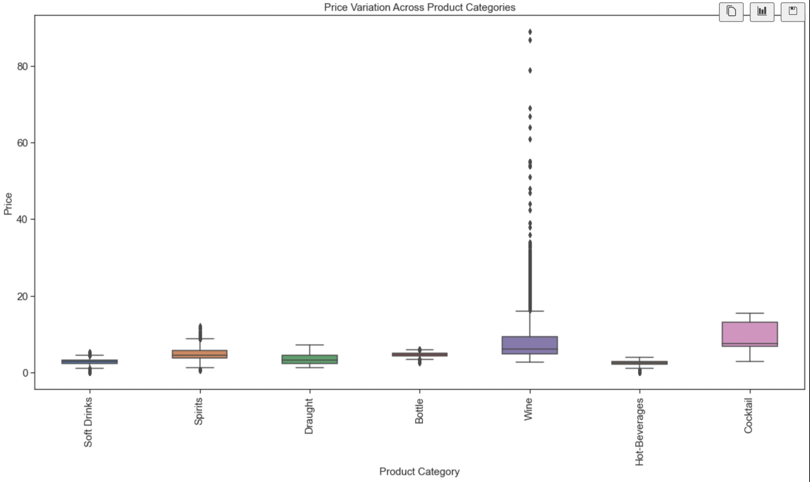
Price Anomalies

Slide 3
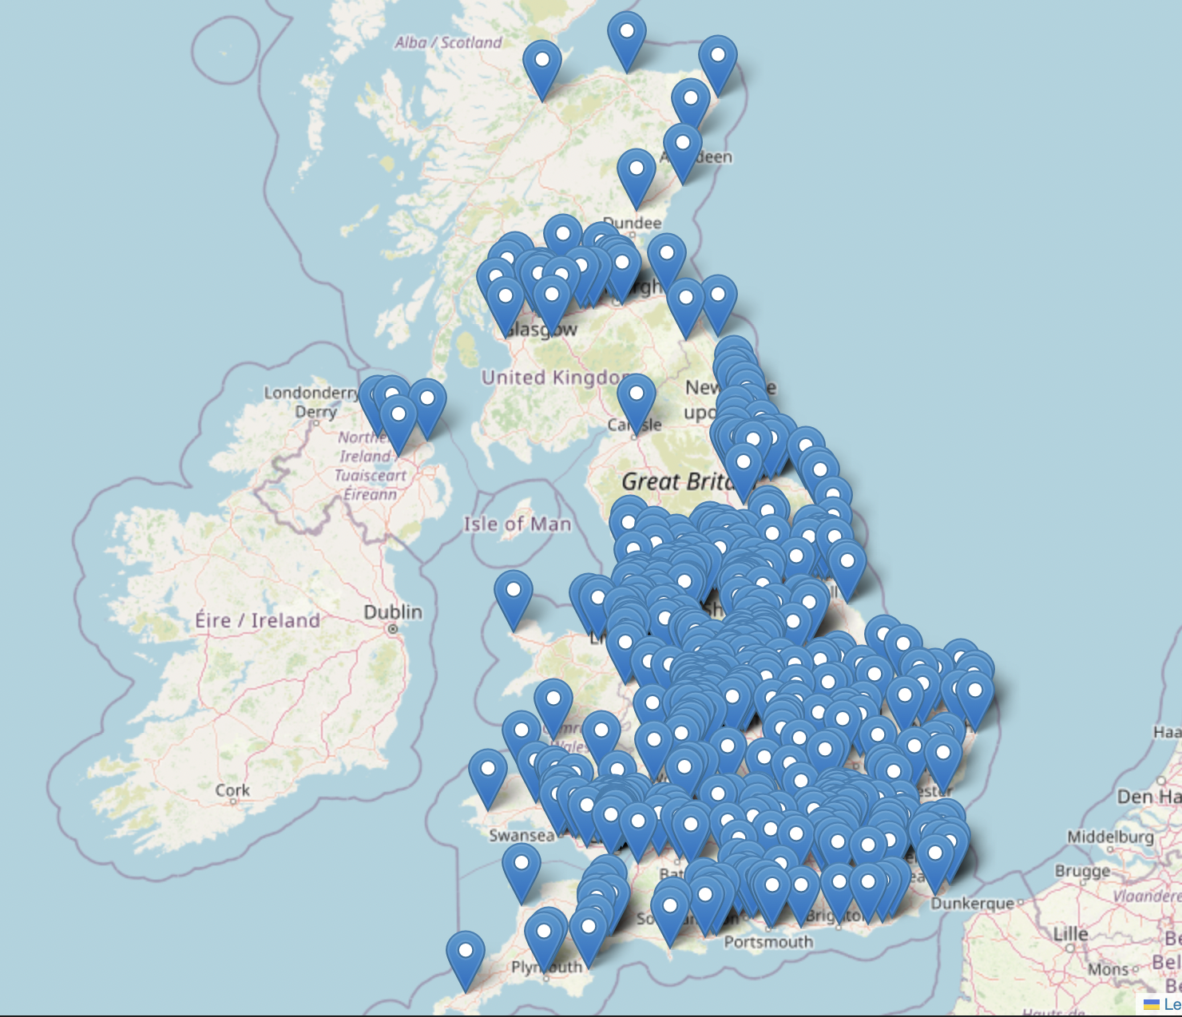
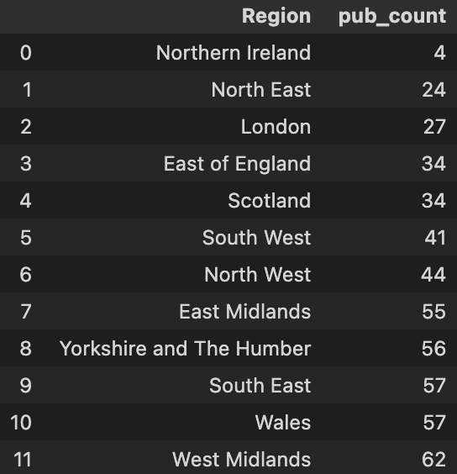
Distribution of Pubs Across UK

Slide 4
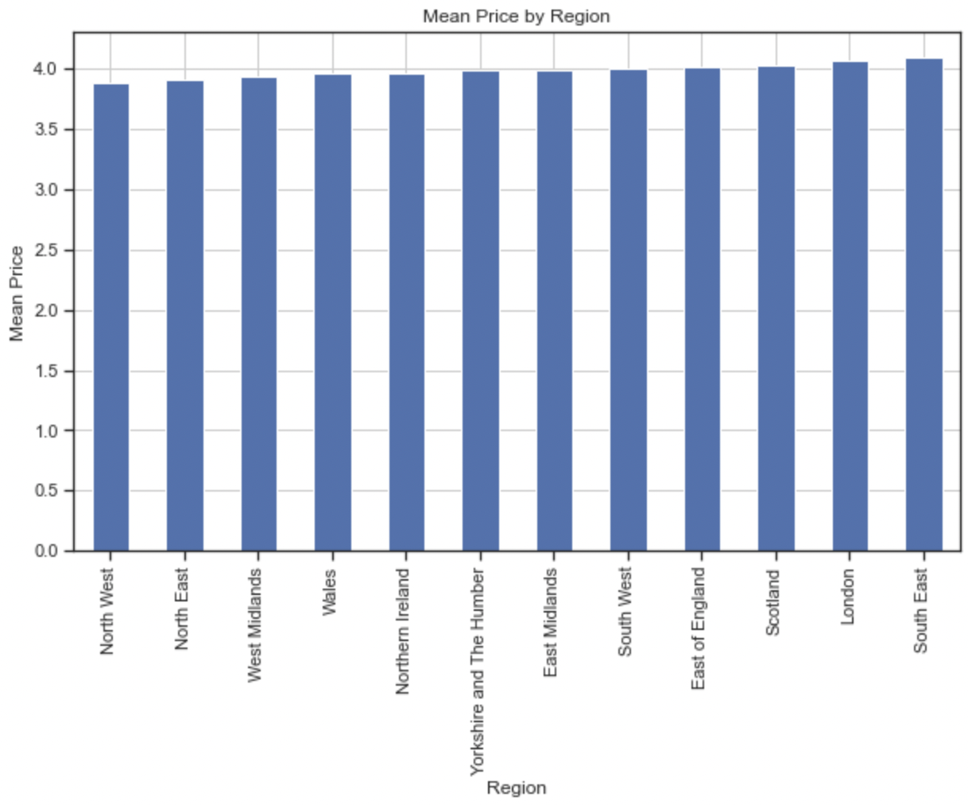
Price of drinks across different regions in UK

Slide 5
Correlation analysis
Correlation between number of pubs and population density among countries: 0.993
Correlation between number of pubs and population density among regions
-0.205 with London
0.574 without London
Insights:
Number of pubs and population density are correlated
The number of pubs in London is significantly lower compared to other regions, affecting the correlation.
Correlation between number of pubs against population density, area and population is 0.4168

Slide 6
Factors that could be affecting number of pubs and pricing
Population Density
Average living expense
Different tax duty among regions
Area of regions

